Slide 1
Super Mario Bros AI
Kenny Haworth

Slide 2
What I intended to do
Create an agent to play Super Mario Bros using a convolutional neural network
The network only takes in raw pixel input (the game screen as a human would see it)

Slide 3
Methods
Change values in CNN and Q Learning
Penalize dying (heuristic)
Stack 4 frames together as input to CNN
Allow 4 frames to pass before choosing a new action
Define all possible actions within a lookup table
Take original image and grayscale it
Reduce the resolution to roughly ¼

Slide 4
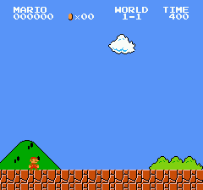

Slide 5
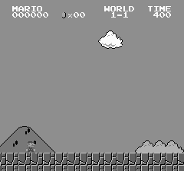

Slide 6
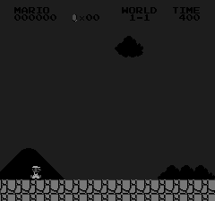

Slide 7


Slide 8
Goals for the Agent
Complete a single level from start to finish
Have the agent play two levels simultaneously
Complete multiple levels in a row
Defeat the most enemies
Collect the most coins
Obtain the most points
Find as many hidden paths as possible

Slide 9
Results
Videos

Slide 10
What I learned
CNNs are expensive!
Delayed rewards causes problems in training
Deep Q Learning and CNNs

